Slide 1
Current State
Most recent valuation date: 6/30/2017
Funding ratio: 74.7%
Unfunded Accrued Liability: $4.427 billion
Employer Contribution Rates (for FY20):
Old Plan / New Plan: 24.66%
GSEPS: 21.64%
Active Members and Payroll:
60,906 (current: ~61,000)
$2.546 billion
Retired Members / Beneficiaries and Payroll:
49,475 (current: ~51,000)
$1.346 billion

Slide 2
Current State
Key valuation assumptions:
Rate of Return / Discount Rate: 7.40%
Will be 7.3% for FY18 and future projections
Long-term target assumption 7.0%
Amortization Period: 25-year closed
Amortization Method: Level Dollar
Asset Smoothing: 5 years
Active Member Payroll: 6.8% growth
Investment return, FY18: 9.2%
Investment return, FYTD19: ~1.5% @ 2/15/19
Low point of (-8%) in mid-December

Slide 3
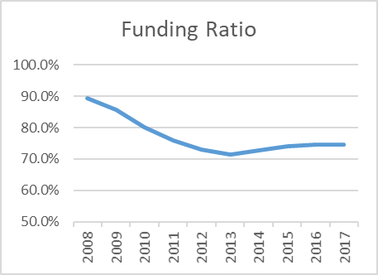
Recent History

Slide 4
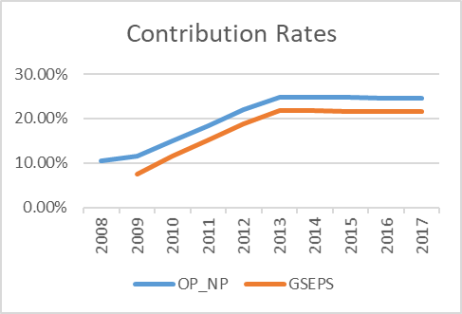
Recent History

Slide 5
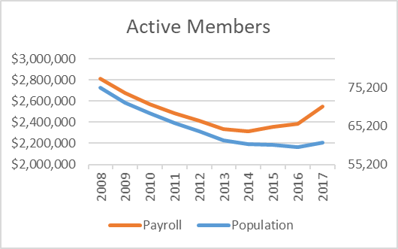
Recent History

Slide 6
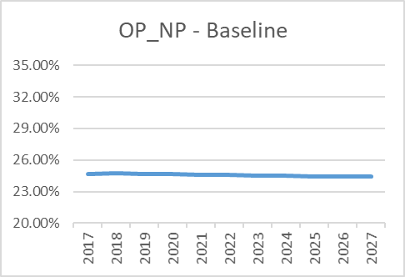
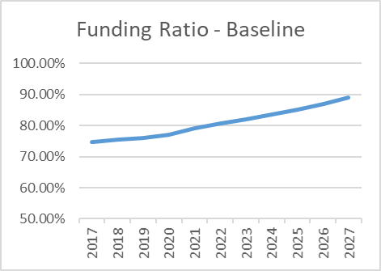
Projections – Baseline
7.30% return on investments in FY 2019
7.30% return on investments in all future years
100% funded ratio projected as of 6/30/2032 valuation

Slide 7
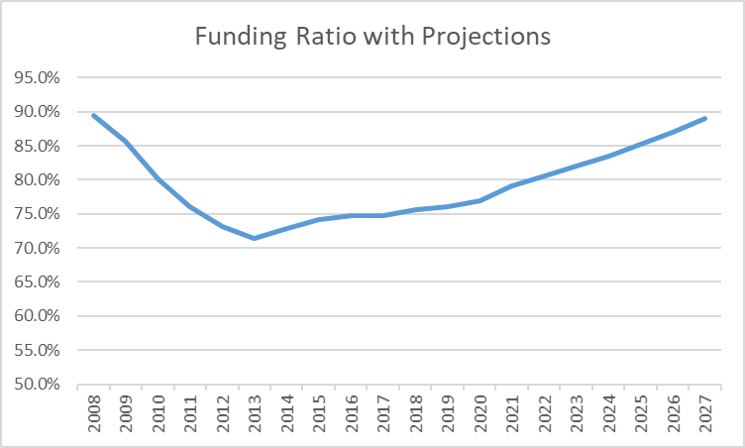
Twenty Years
7.3% discount rate and assumed RoR, all years
Includes 9.2% RoR for FY18
Includes 13th and 14th checks paid 7/1/2018 and 1/1/2019
100% funded ratio projected as of 6/30/2032 valuation

Slide 8
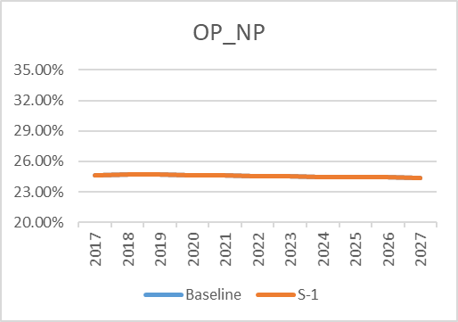
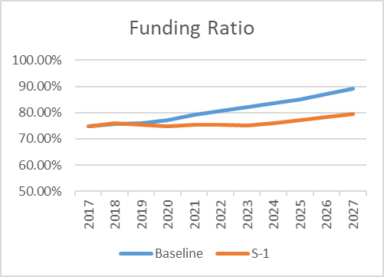
Scenario “S-1”
Changes from Baseline:
0.00% return on investments in FY 2019
7.30% return on investments in all future years
100% funded ratio projected as of 6/30/2036 valuation (S-1)
No change in Contribution Rates

Slide 9
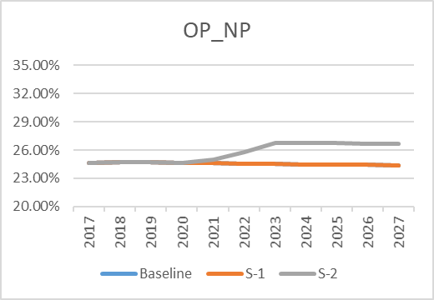
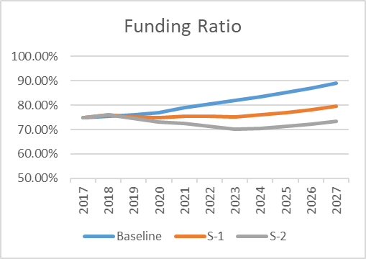
Scenario “S-2”
Changes from Baseline:
(-5.00%) return on investments in FY 2019
7.30% return on investments in all future years
100% funded ratio projected as of 6/30/2038 valuation (S-2)
Contribution Rates final increase of 2.27% ($59 million per year)

Slide 10
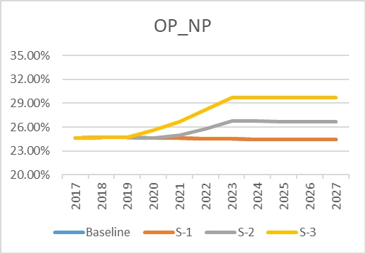
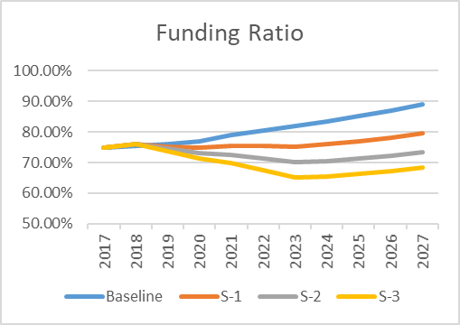
Scenario “S-3”
Changes from Baseline:
(-10.00%) return on investments in FY 2019
7.30% return on investments in all future years
100% funded ratio projected as of 6/30/2039 valuation (S-3)
Contribution Rates final increase of 5.27% ($137 million per year)

Slide 11
Post-Retirement Adjustments – Costs
COLA Type | Assumptions ($2.6 billion payroll) | Unfunded Liability (UAL) Change | Amount Amortized over 25 Years | Increase in Employer Contribution Rate
3% | No retirement income cap | +$375 million | $33.1 million per year | +1.27%
1% | No retirement income cap | +$125 million | $11 million per year | +0.42%
3% | Only on income up to $30,000 | +$278 million | $24.5 million per year | +0.94%
3%, one-time (“13th check”) | Only on income up to $30,000 | +$30.6 million | $2.7 million per year | +0.11%
1%, one-time (“13th check”) | Only on income up to $30,000 | +$10.2 million | $900,000 per year | +0.04%
Prefunded 1% | No retirement income cap | +1.26 billion | $111.1 million per year | +4.27%

Slide 12
Next Steps
Currently working on draft actuarial valuation reports
Annual Board meetings (all systems): April 18, 2019
Review and approve valuation reports
Consider payment of post-retirement adjustments
I’m available, as always, to answer questions

